Slide 1
Using the 10” Square Lodge Grill
Easy Cooking and Cleaning
by Doc Newman

Slide 2
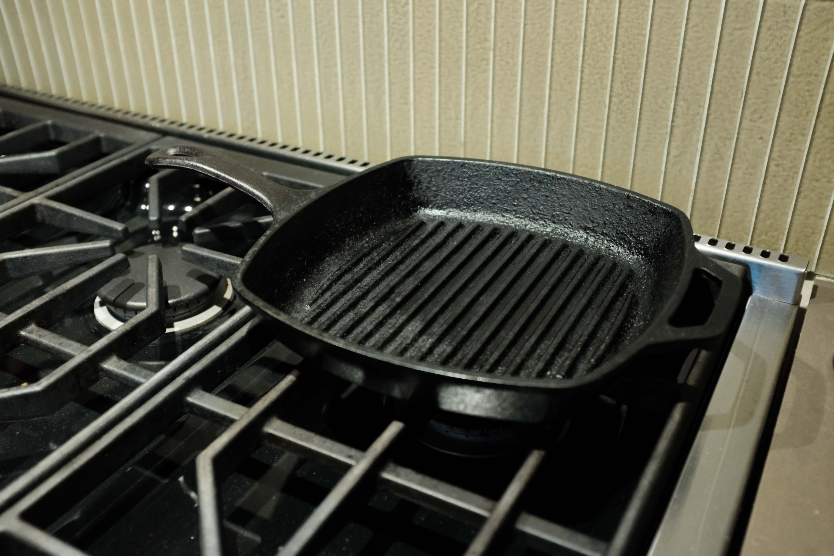
Grill, just as it has been stored

Slide 3
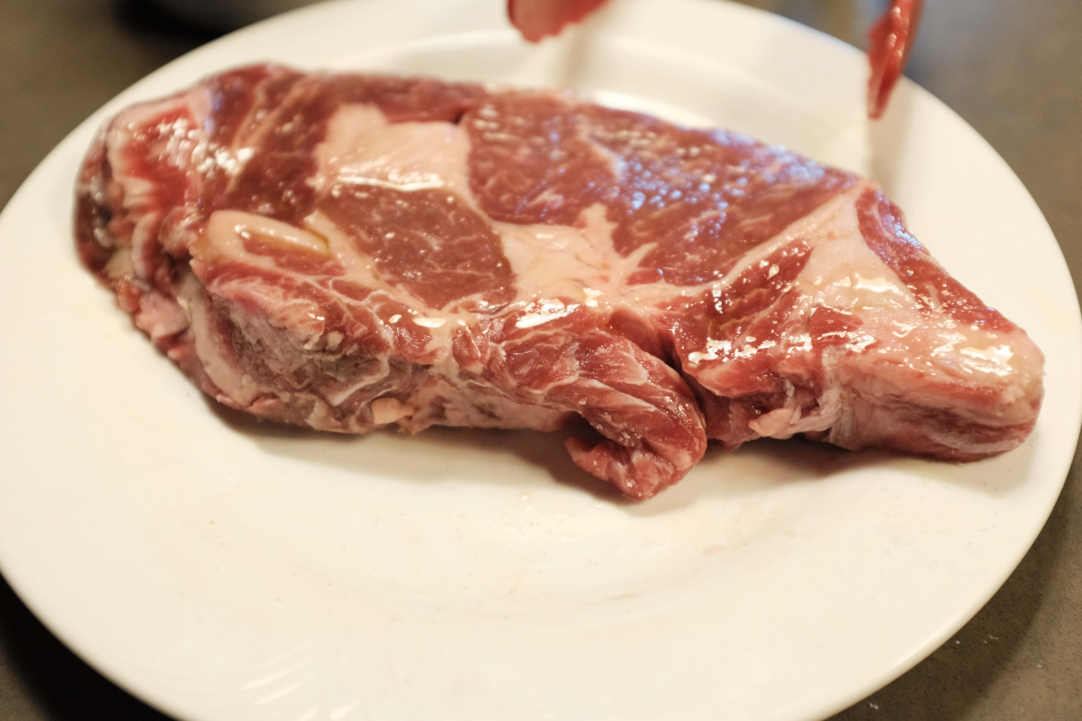
Ribeye with salt removed and coated with olive oil

Slide 4
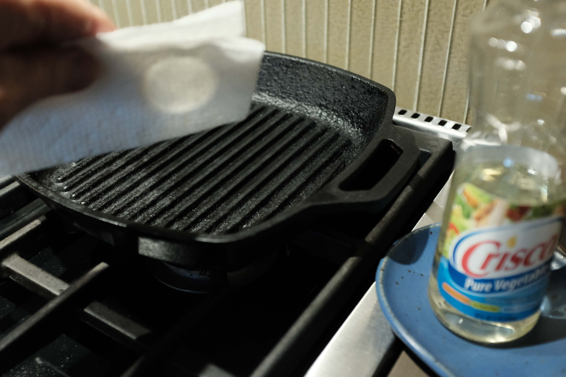
Vegetable oil on paper towel for “seasoning”

Slide 5
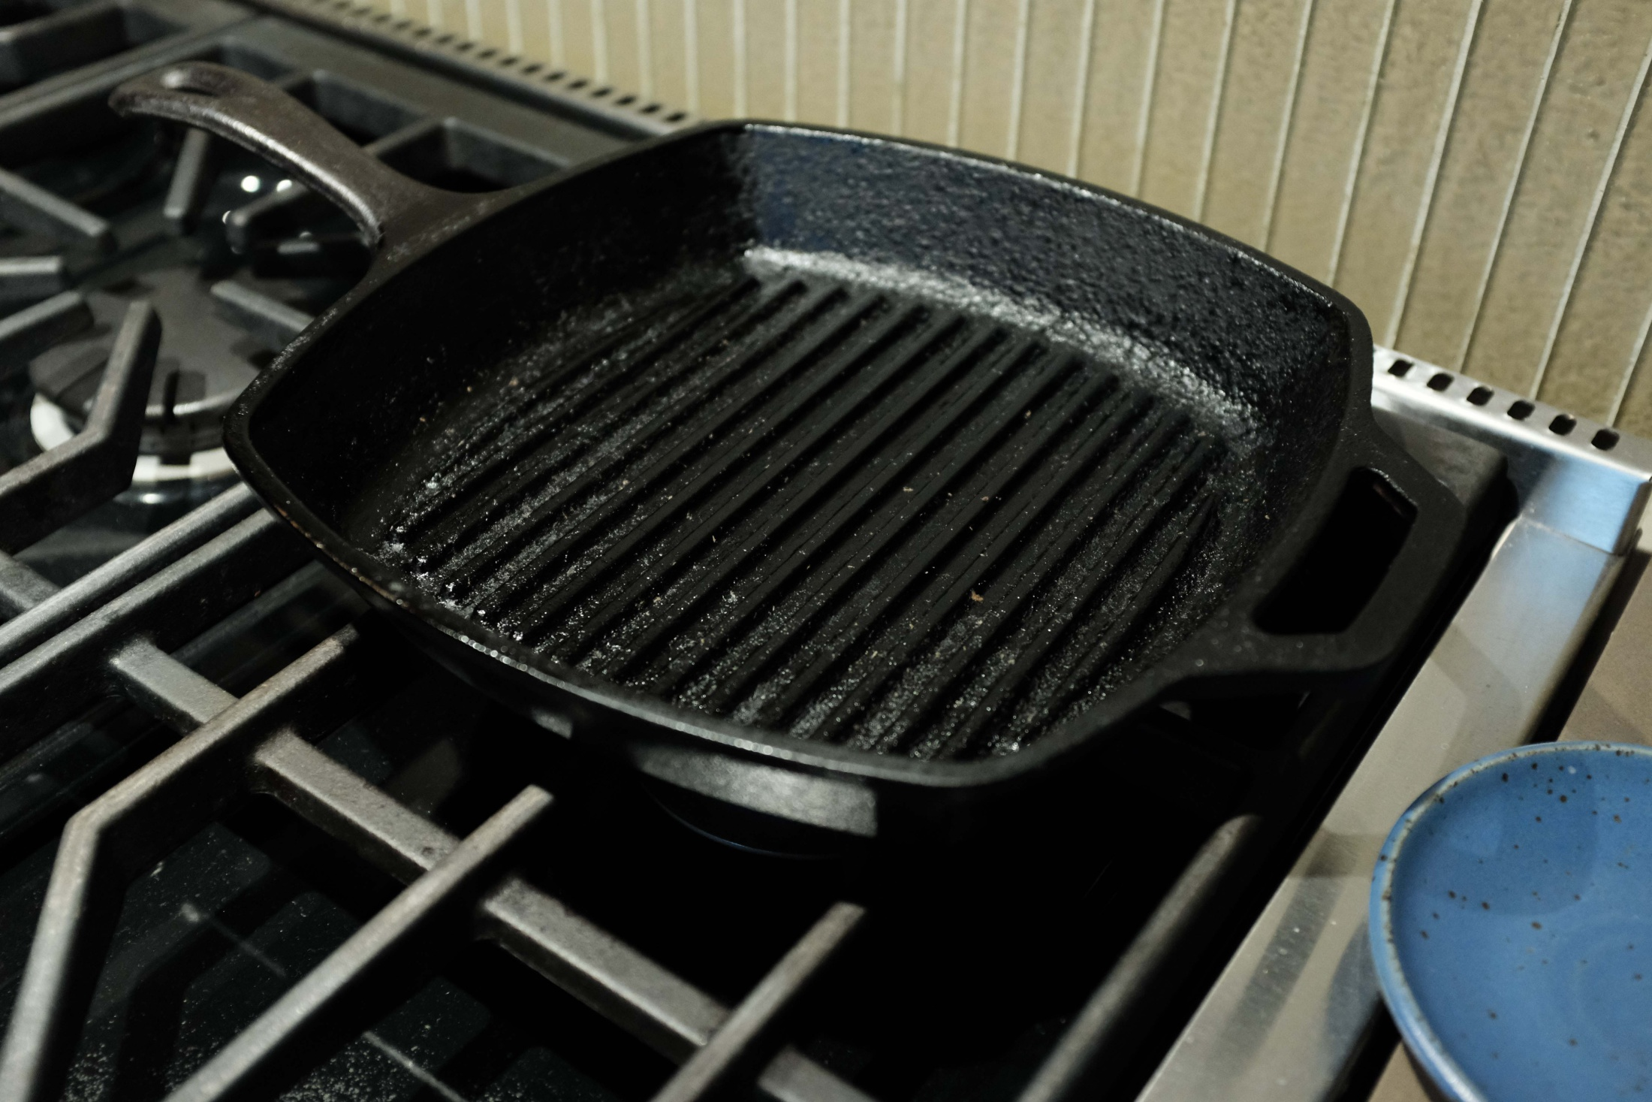
Grill oiled and ready to cook

Slide 6
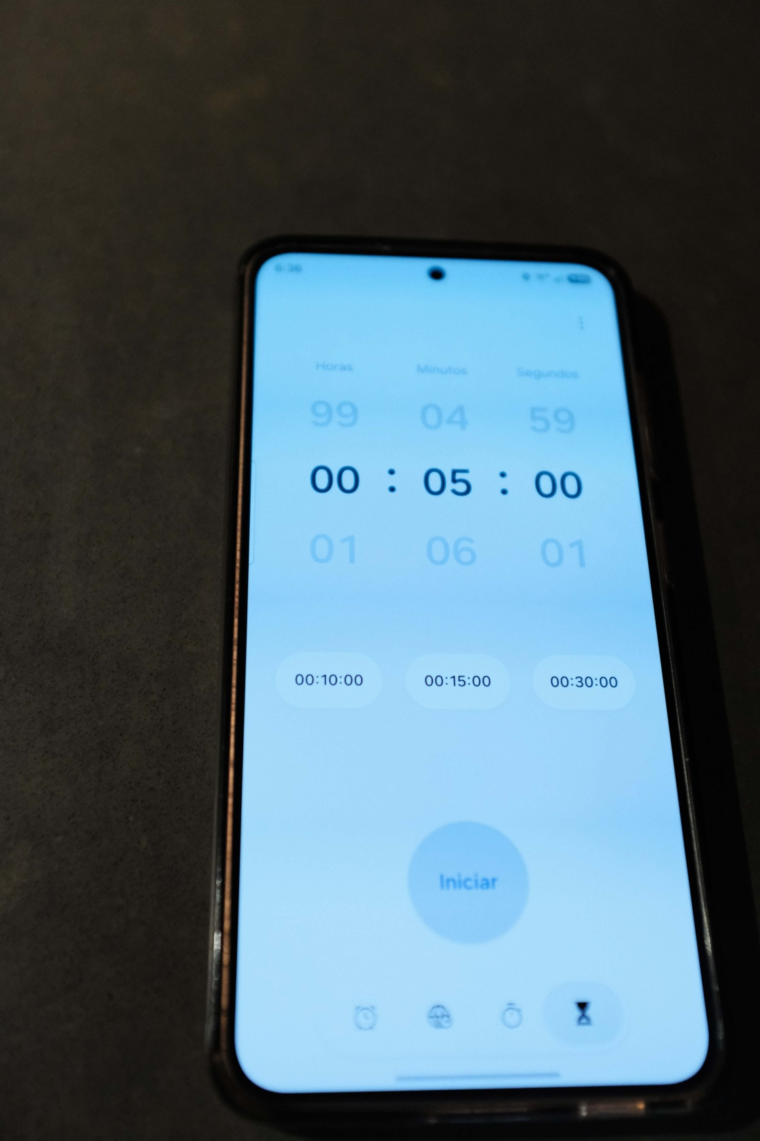
5 minute timer
to heat the grill
before starting
to cook

Slide 7
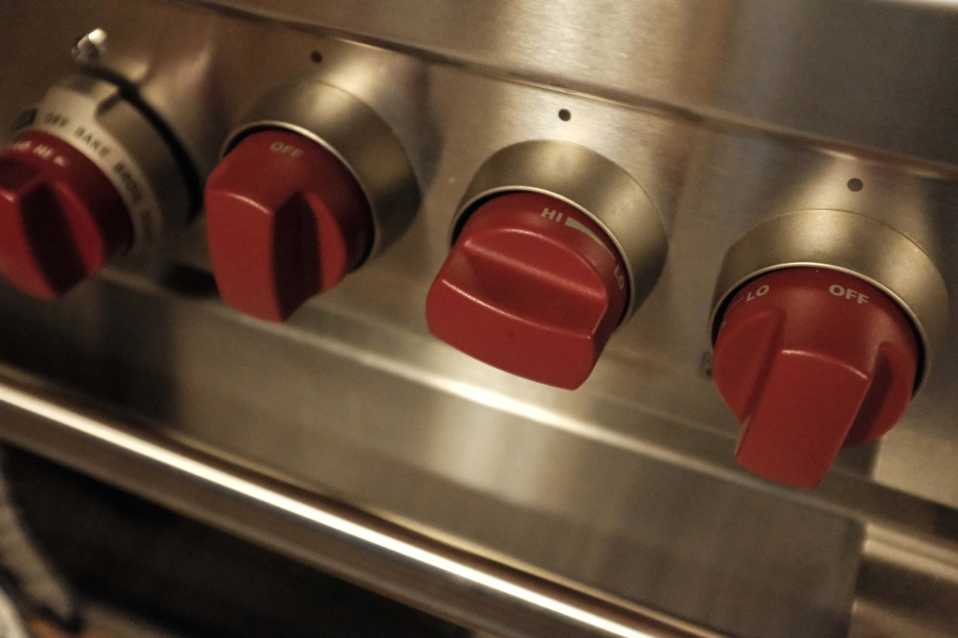
High heat for 5 minutes!

Slide 8
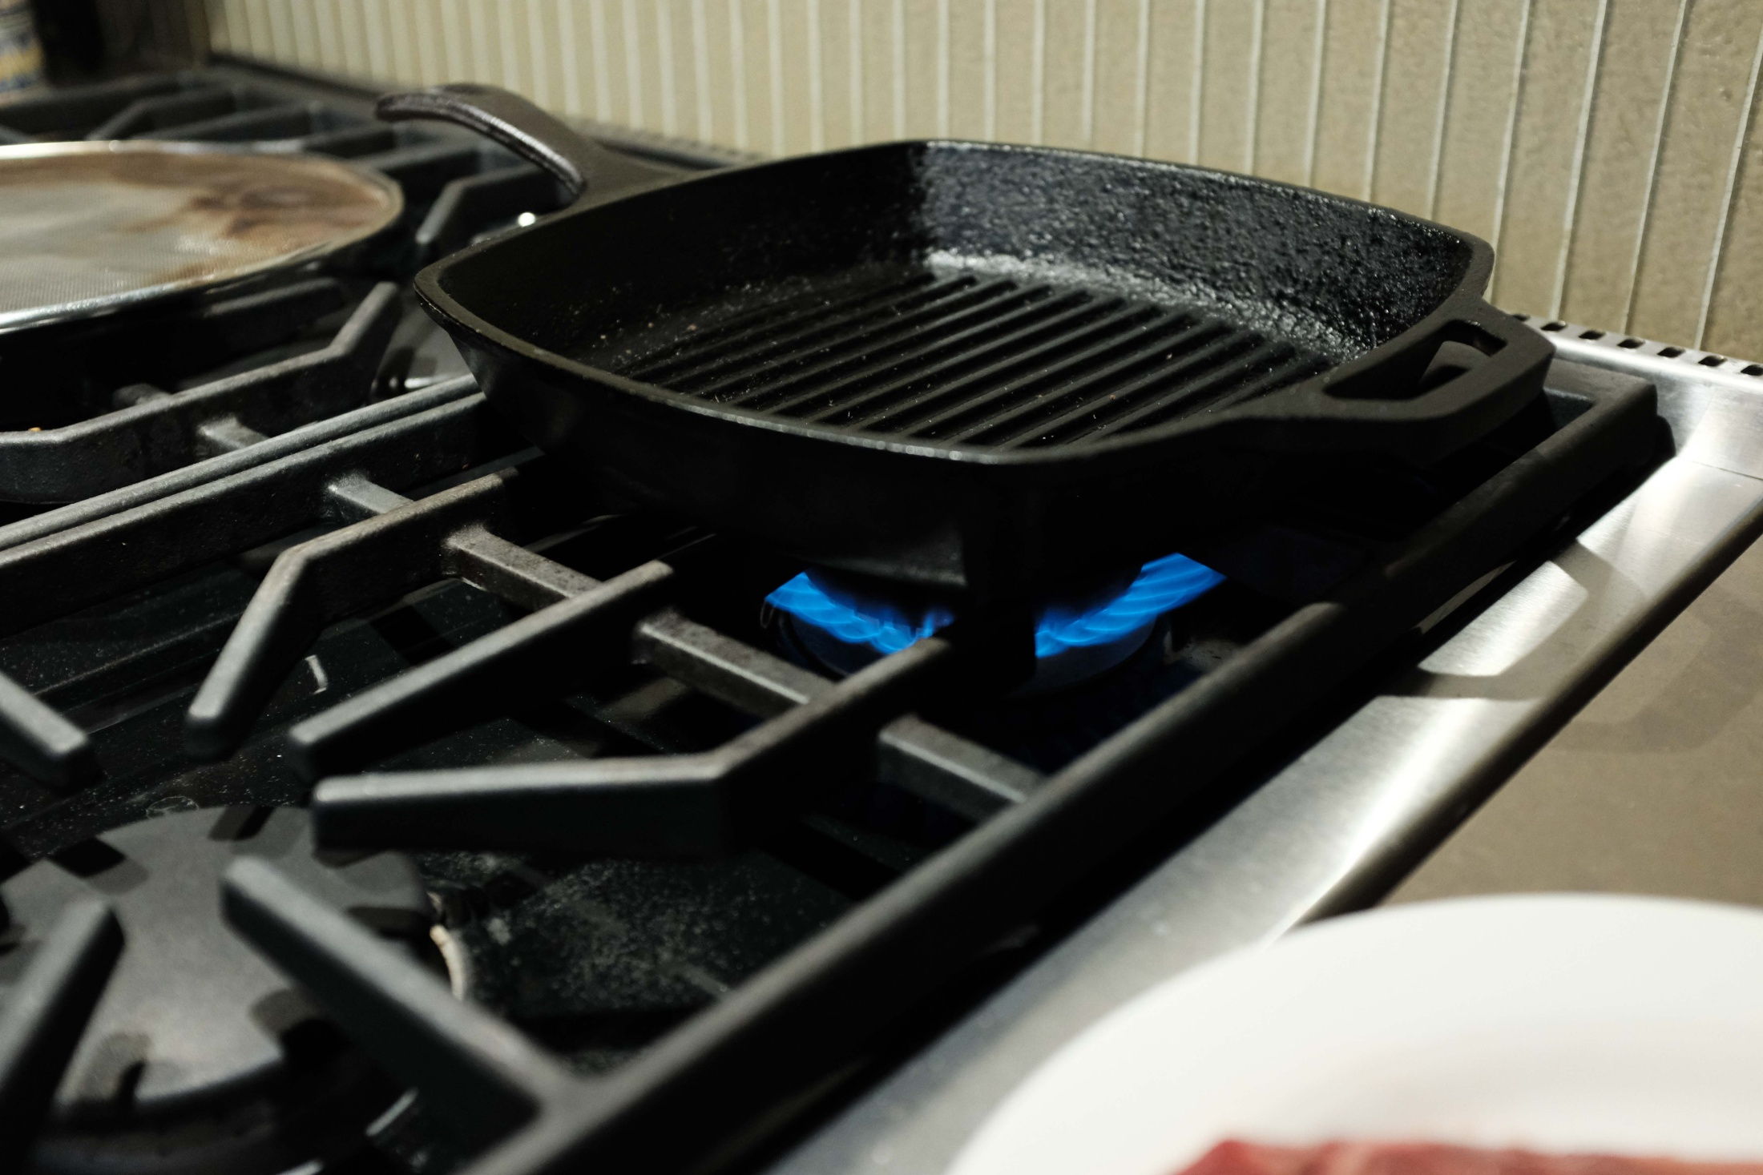
Grill pre-heating, empty, on high flame

Slide 9
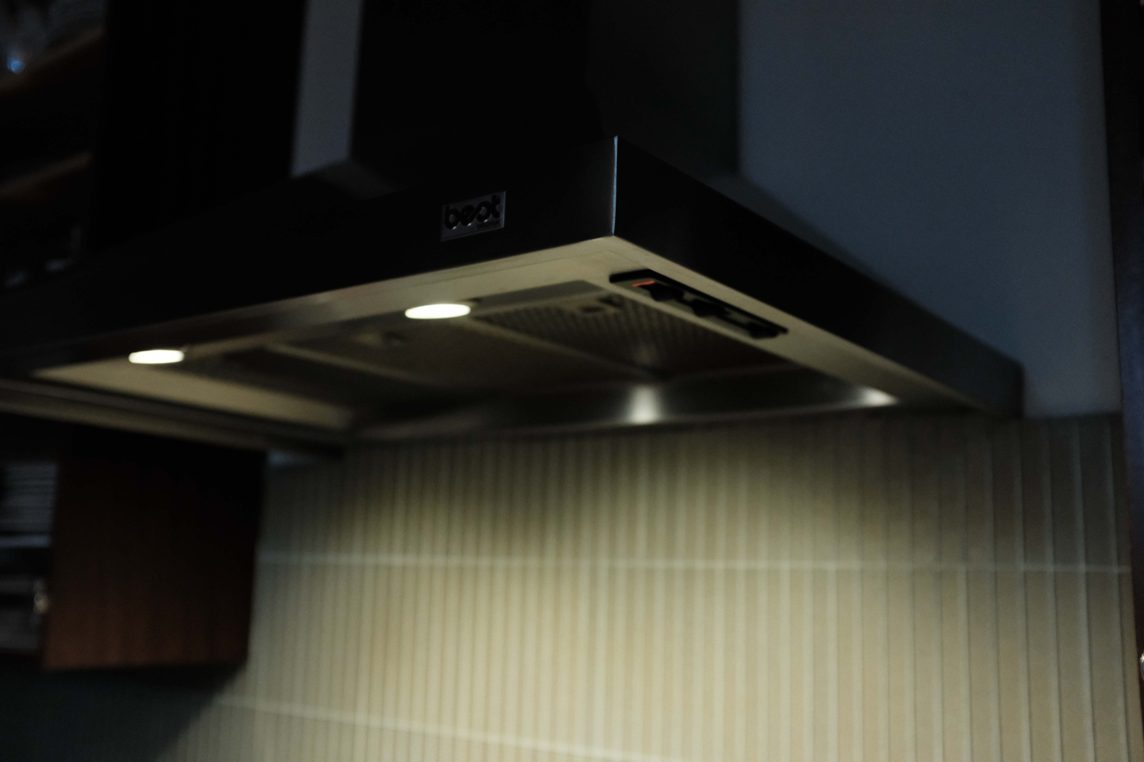
Vent on to eliminate smoke, even during pre-heating

Slide 10
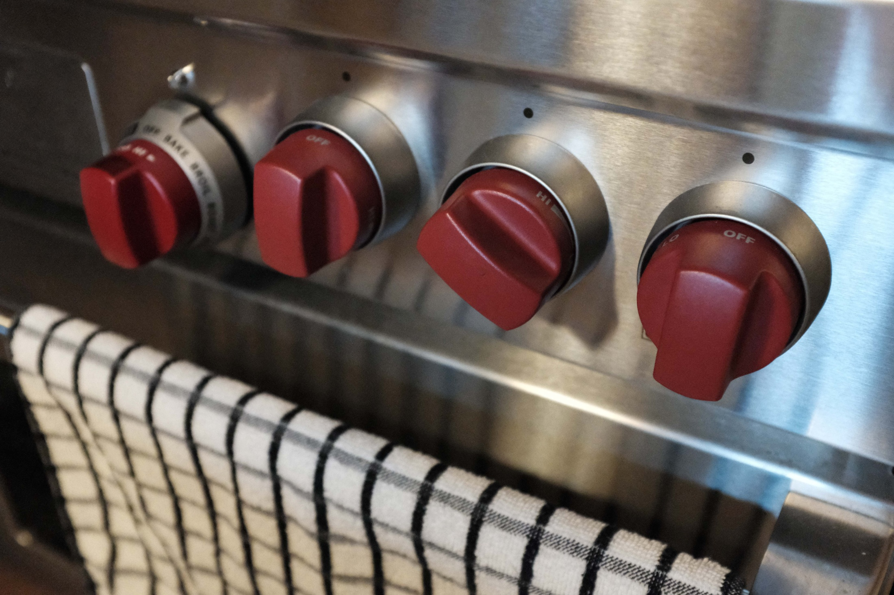
Heat to Medium High for Cooking

Slide 11
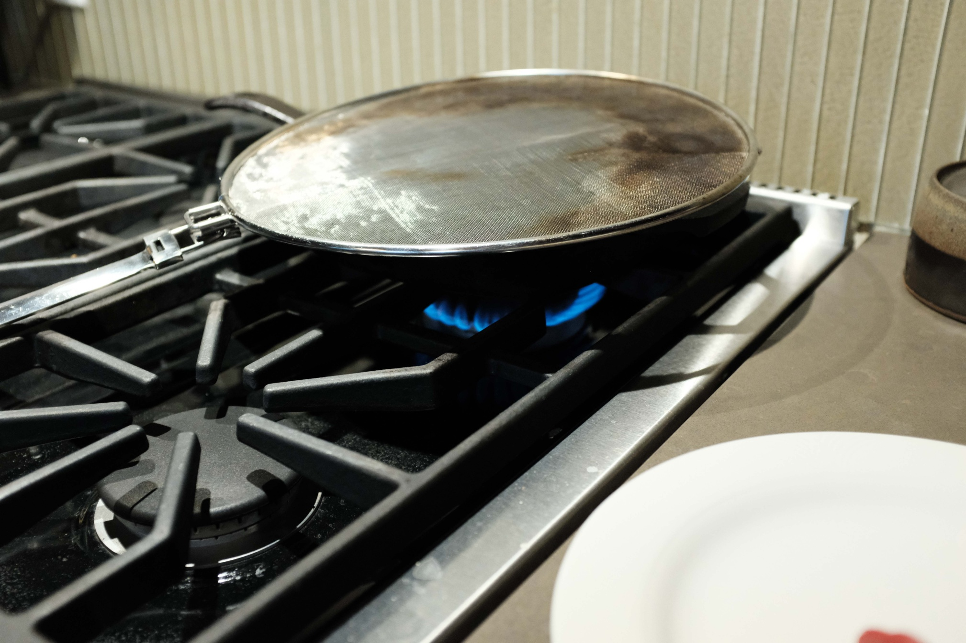
Screen on cooking steak to reduce splatter and smoke,
loosely open at rear to prevent steaming.

Slide 12
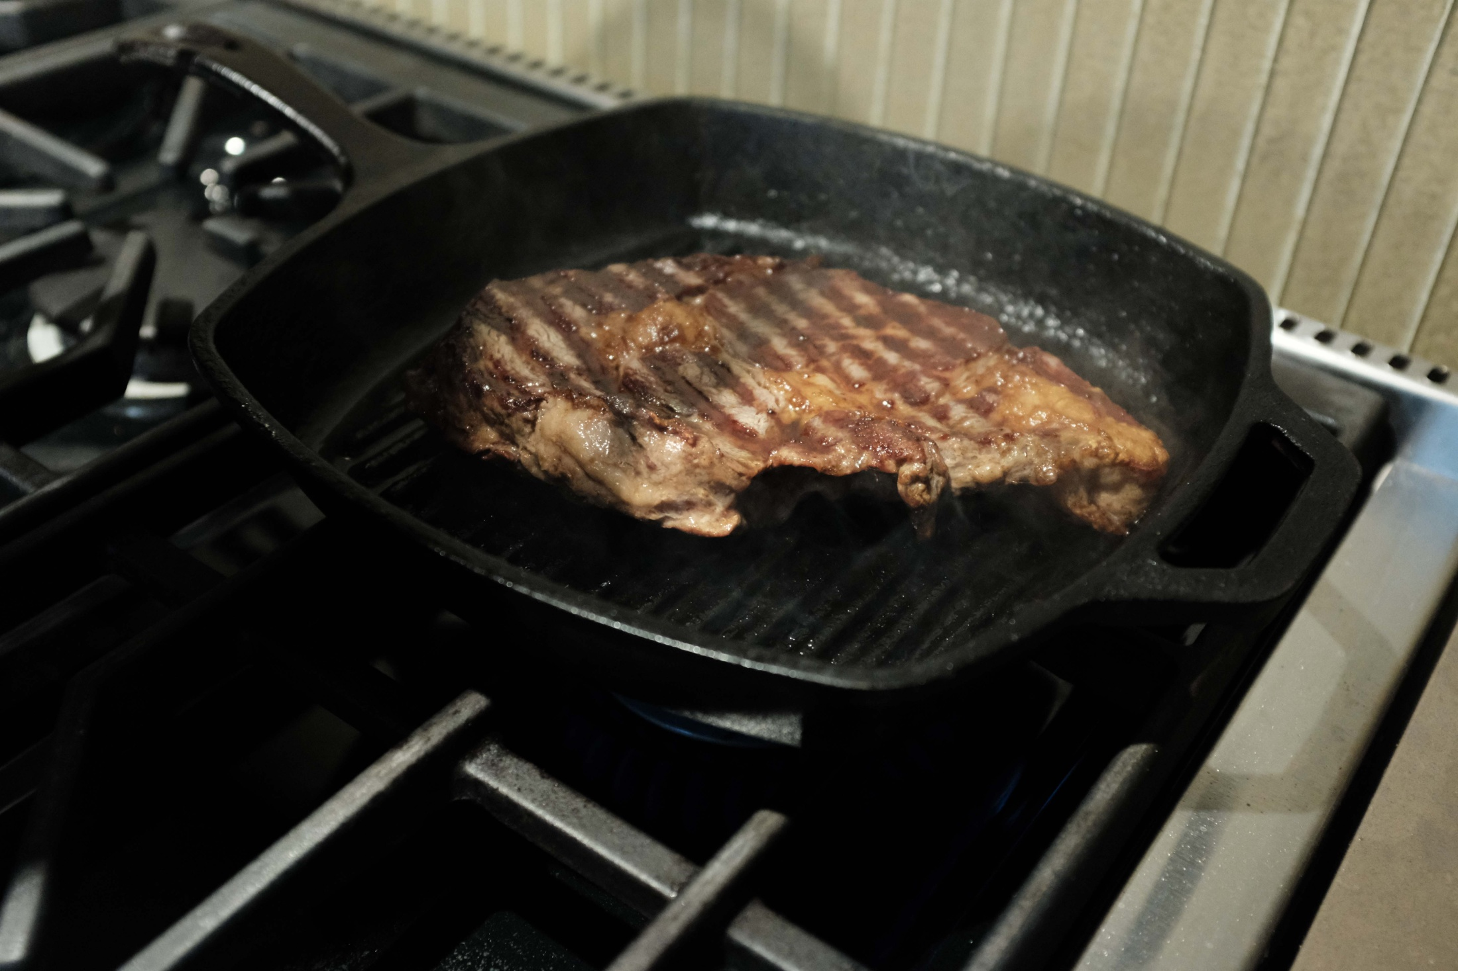
YUM!!! Looks like its been cooked on an outdoor BBQ.

Slide 13
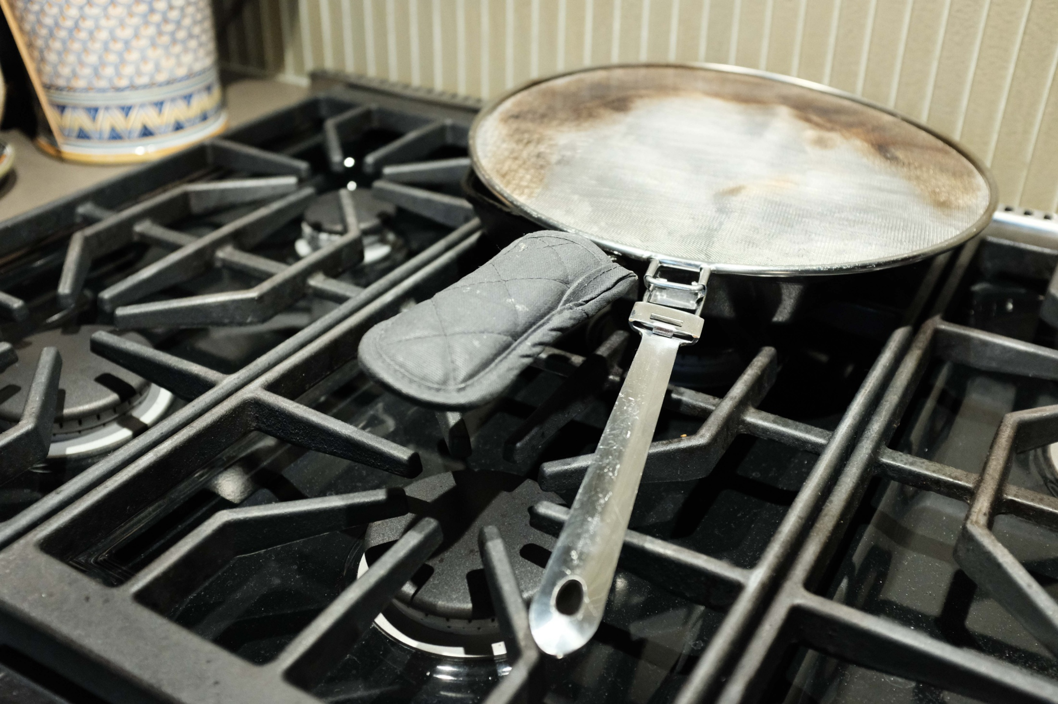
Grill off hot burner to cool. Screen still in place. Mitt.

Slide 14
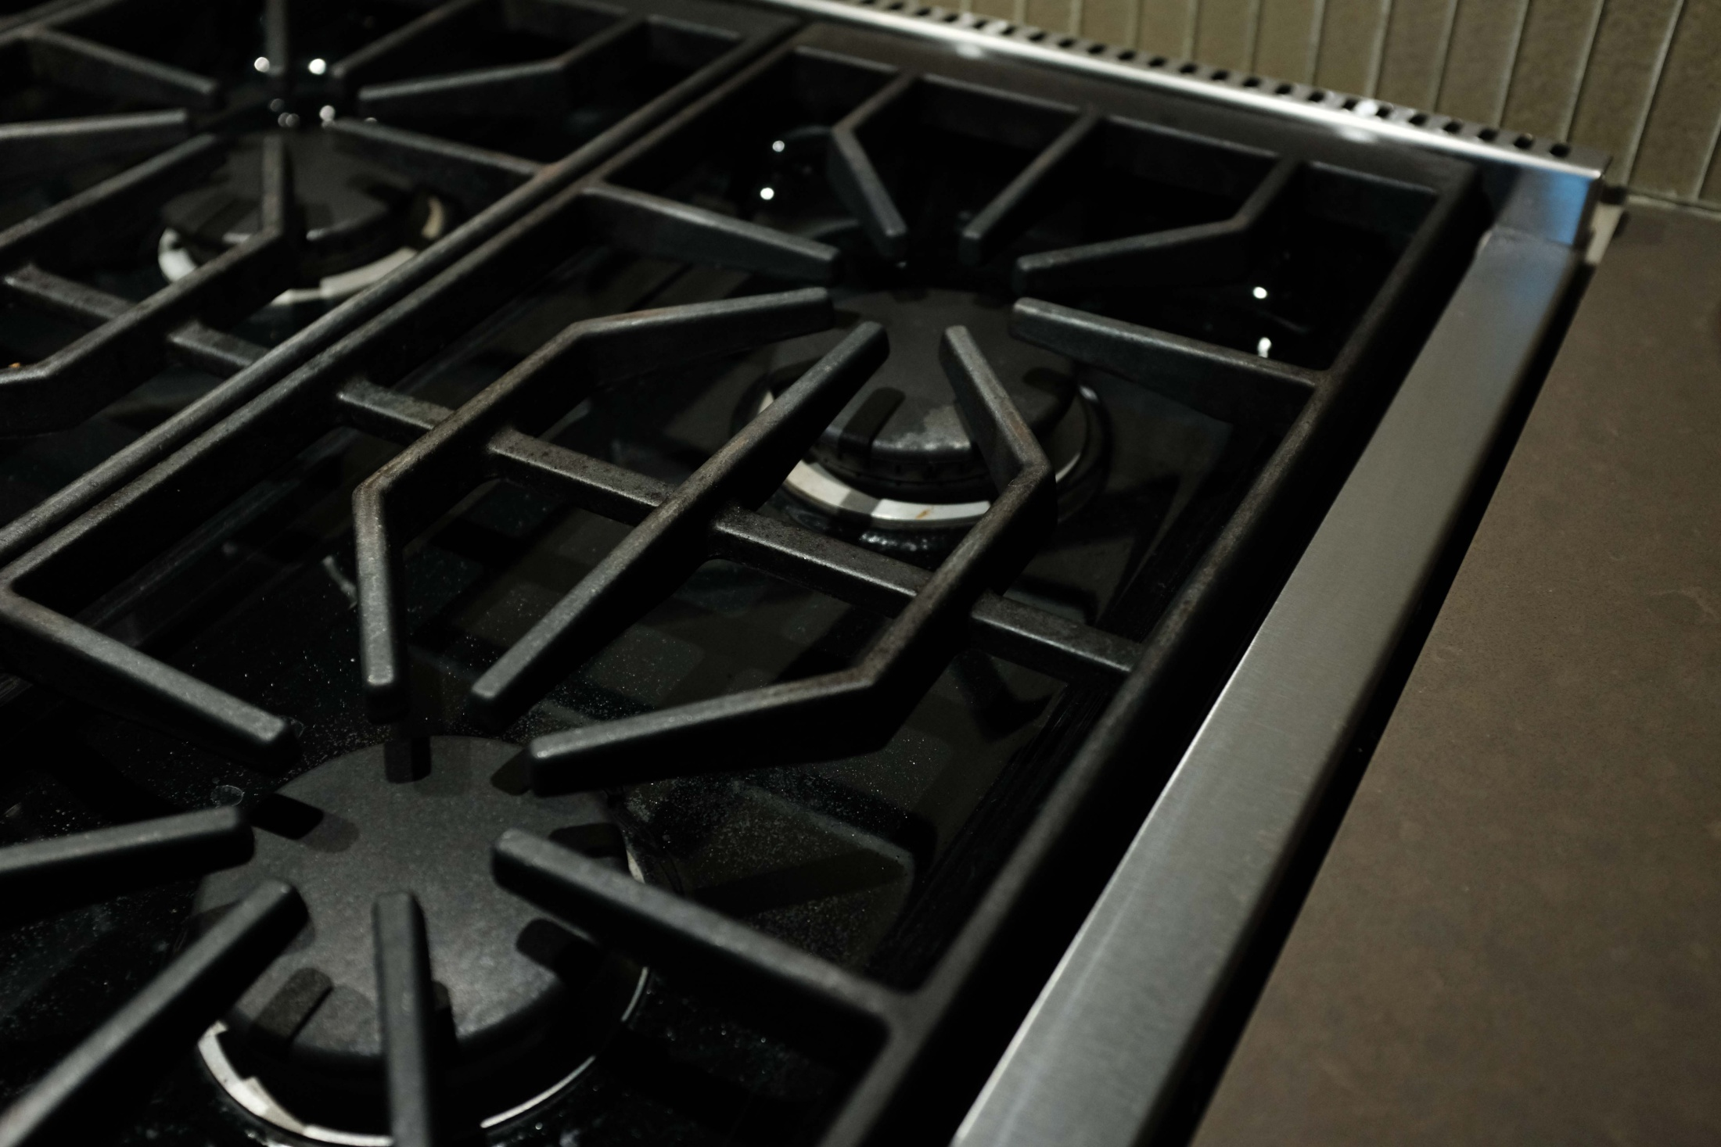
Clean stove thanks to cooking screen

Slide 15
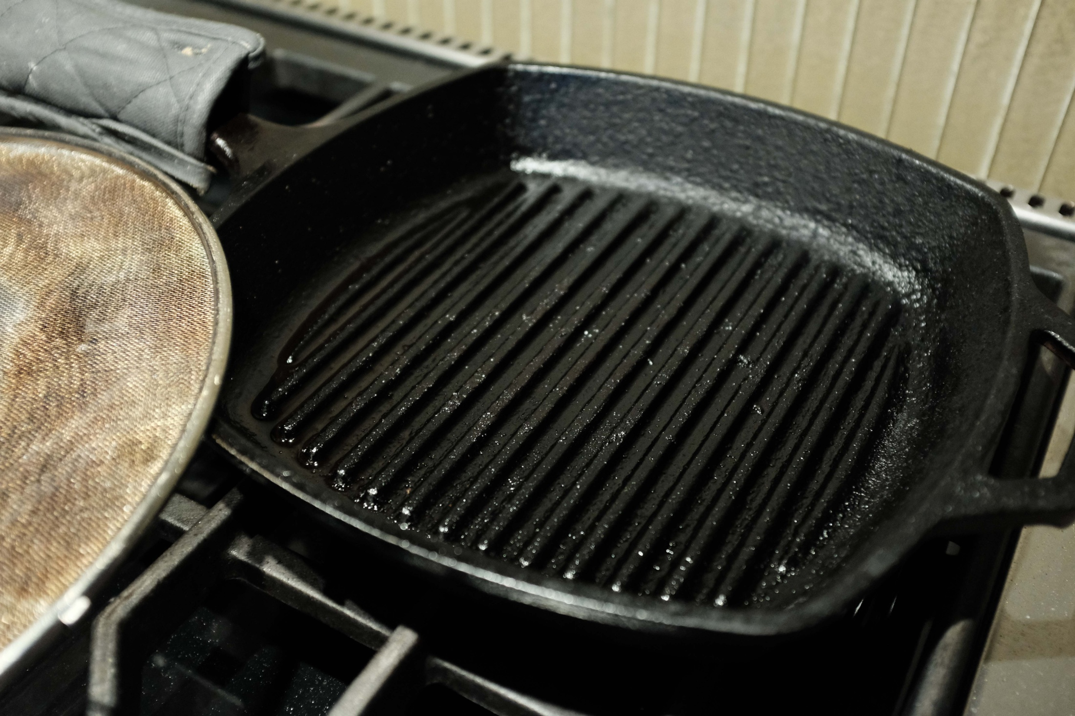
Extra grease from ribeye fat after cooking.

Slide 16
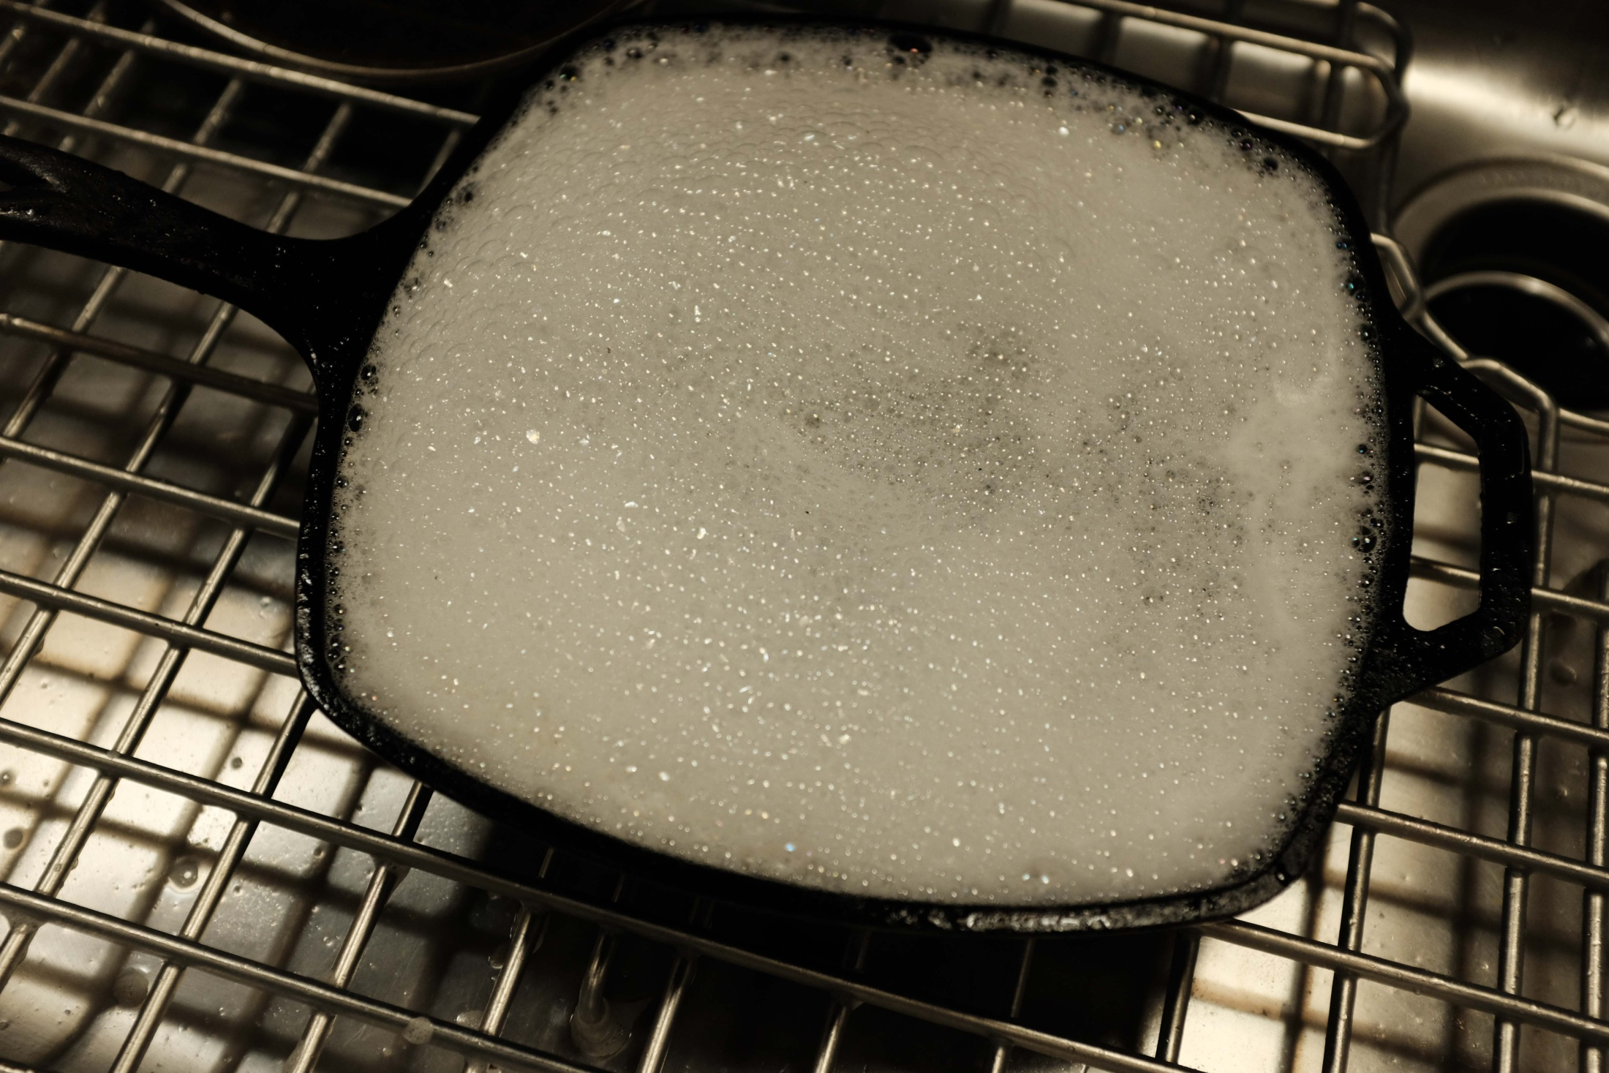
Soaking in hot water with Dawn for 15 – 30 minutes

Slide 17
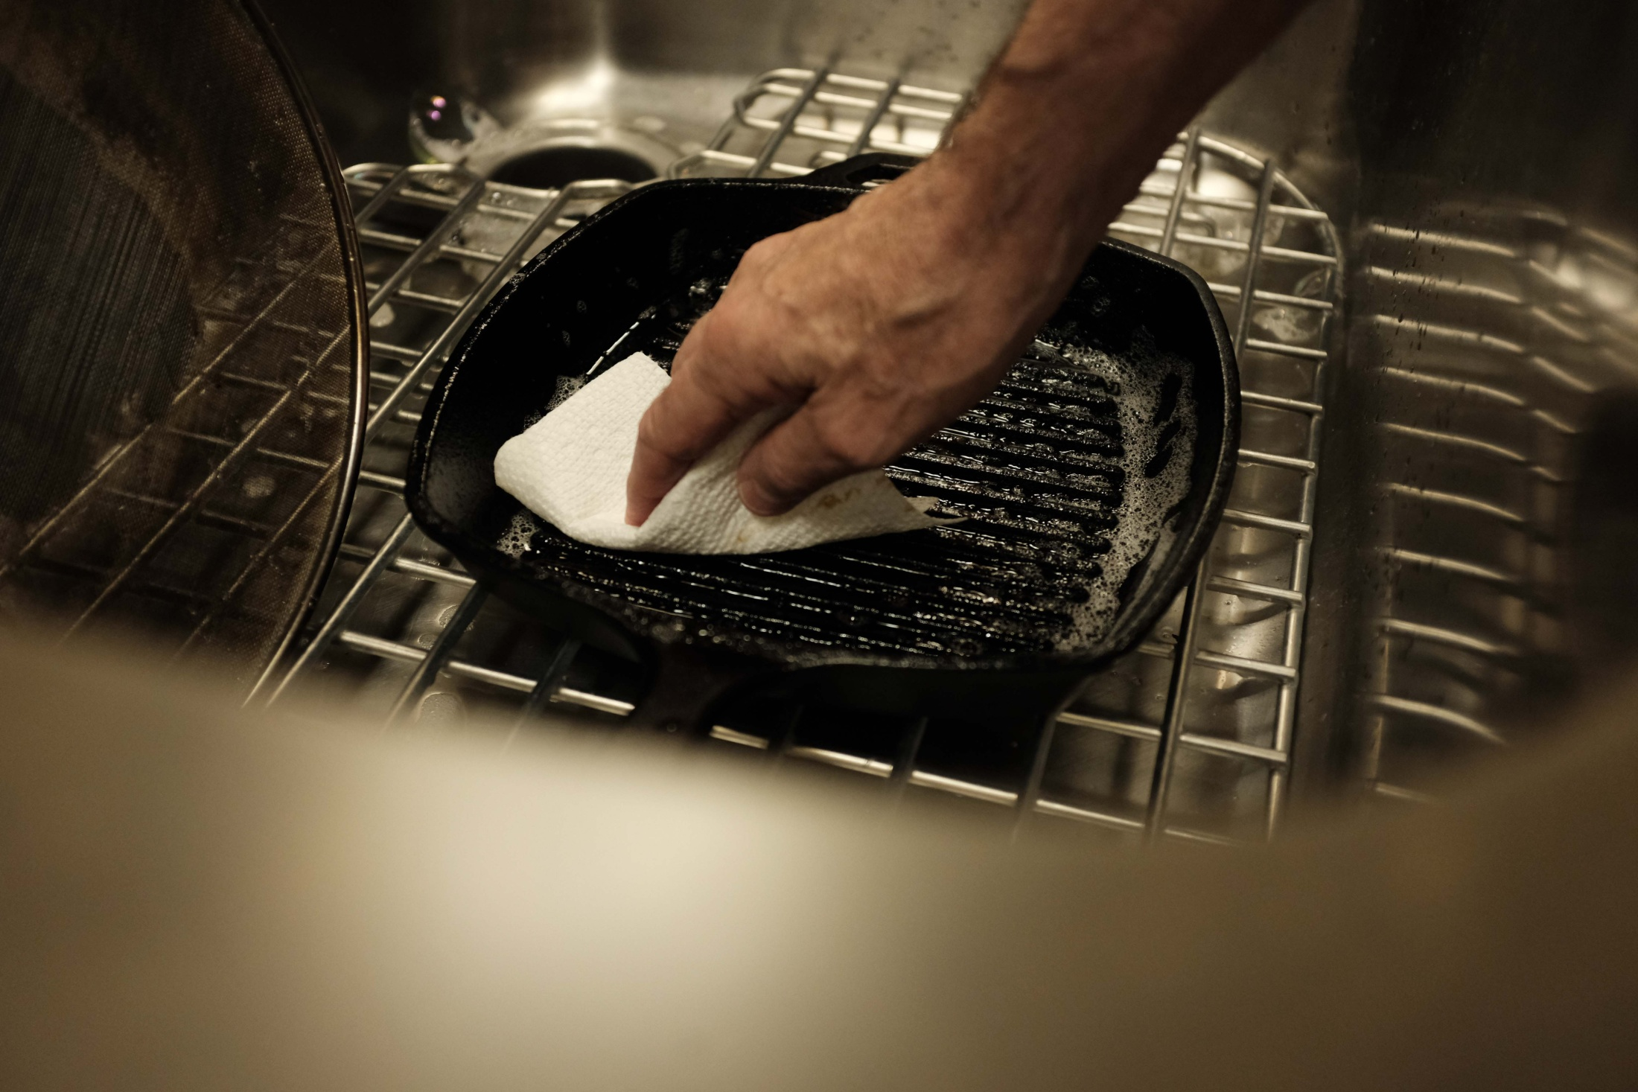
Paper towel cleanup after discarding soapy water

Slide 18
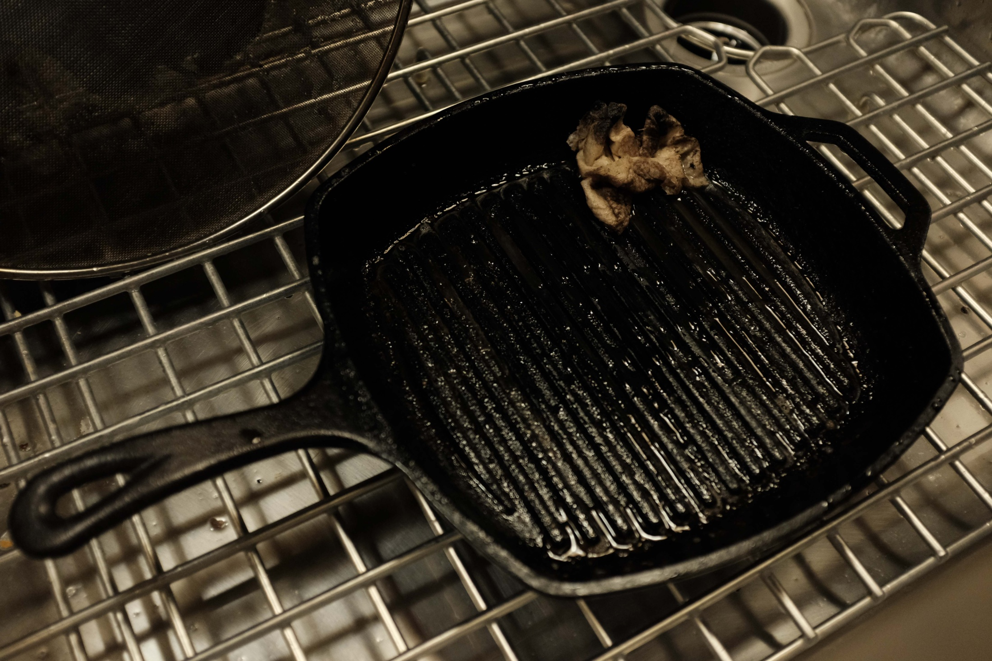
First towel is messy

Slide 19
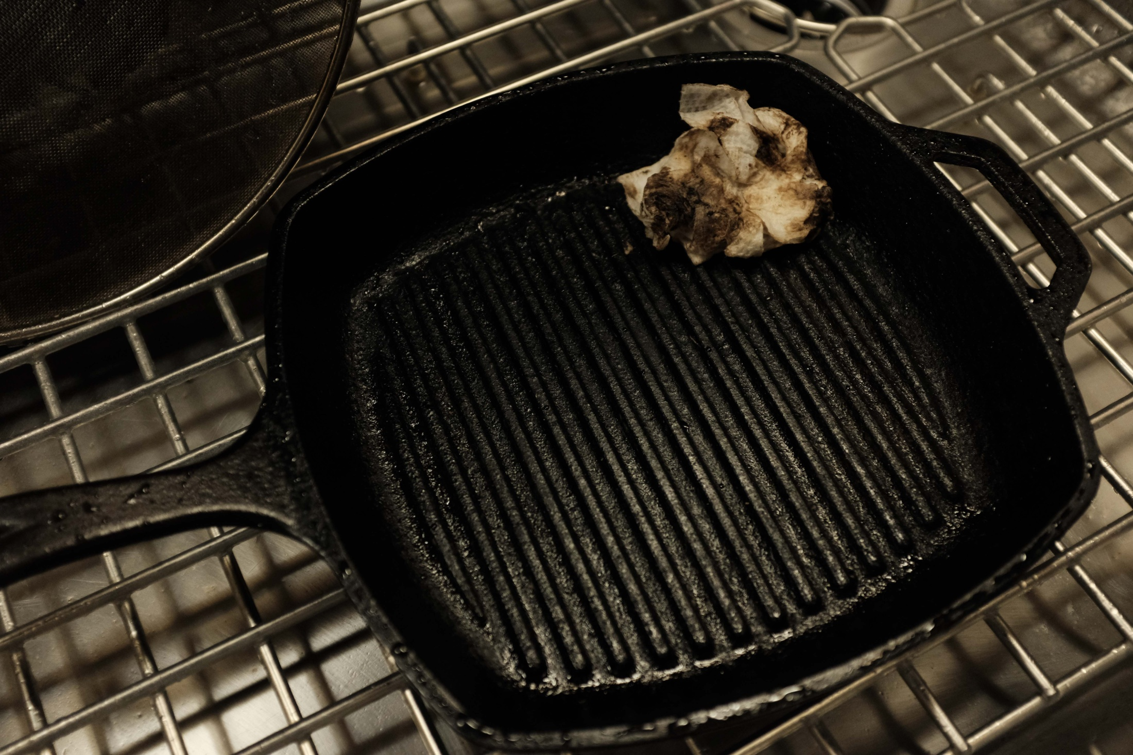
Second towel is also messy

Slide 20
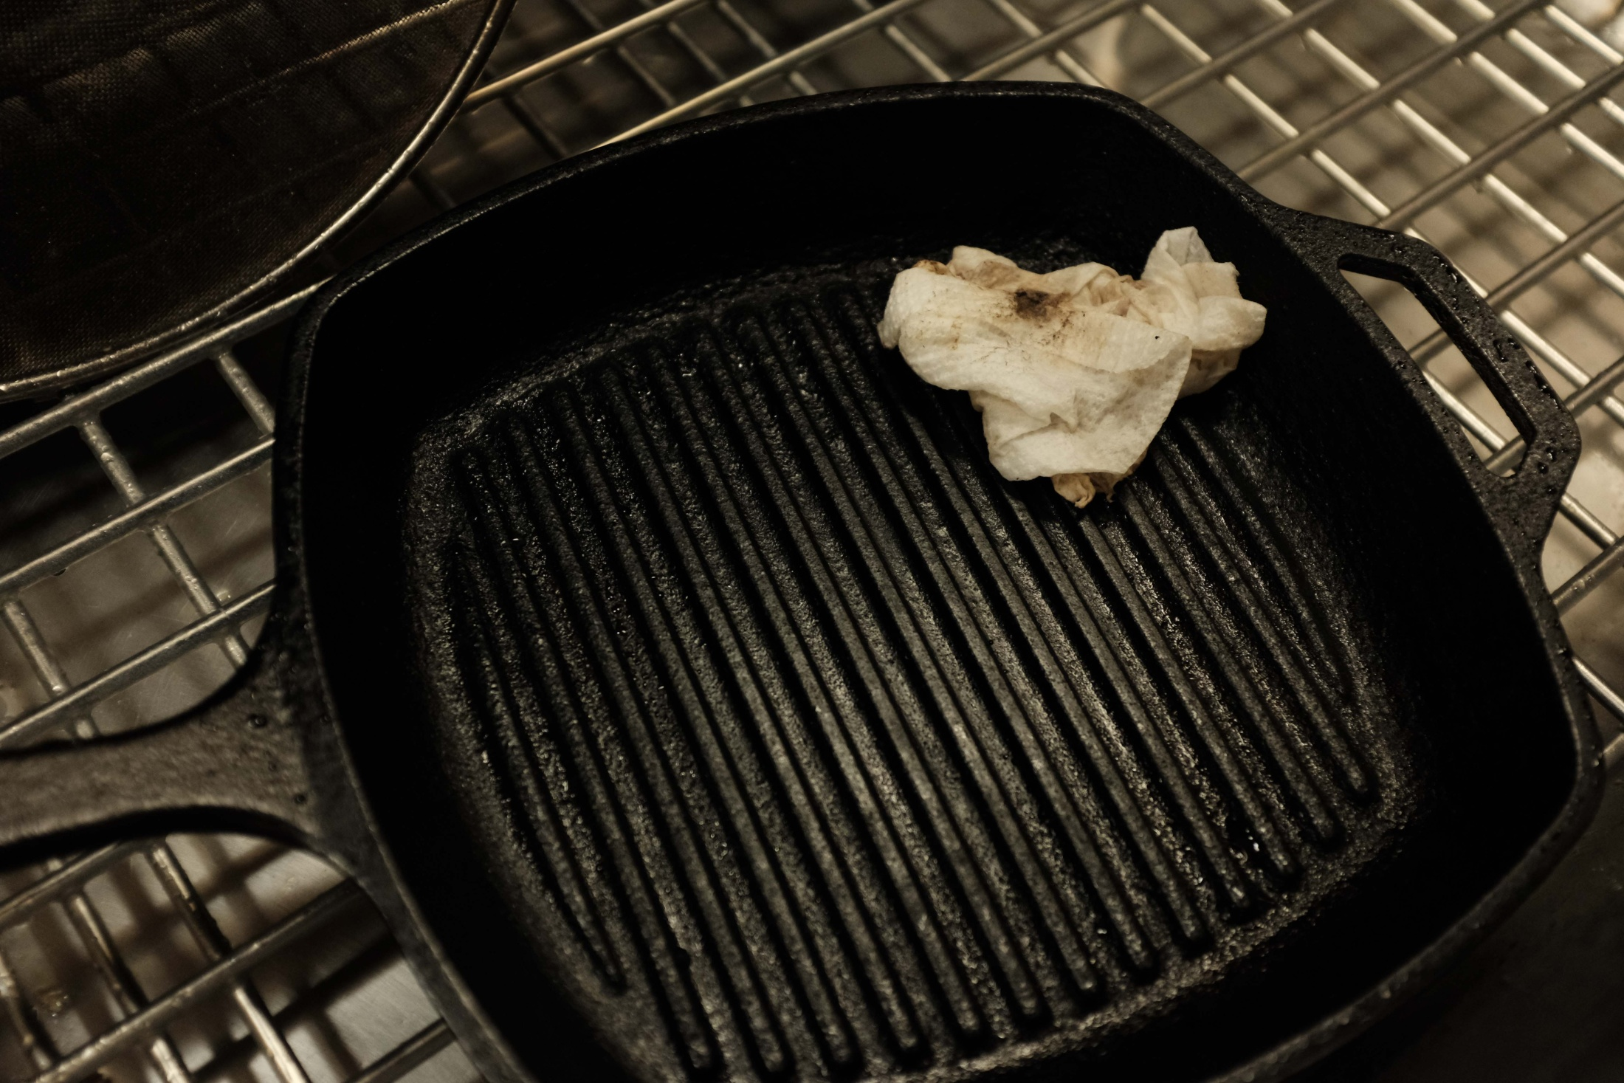
Third towel pretty clean. Grill is ready for rinsing.

Slide 21
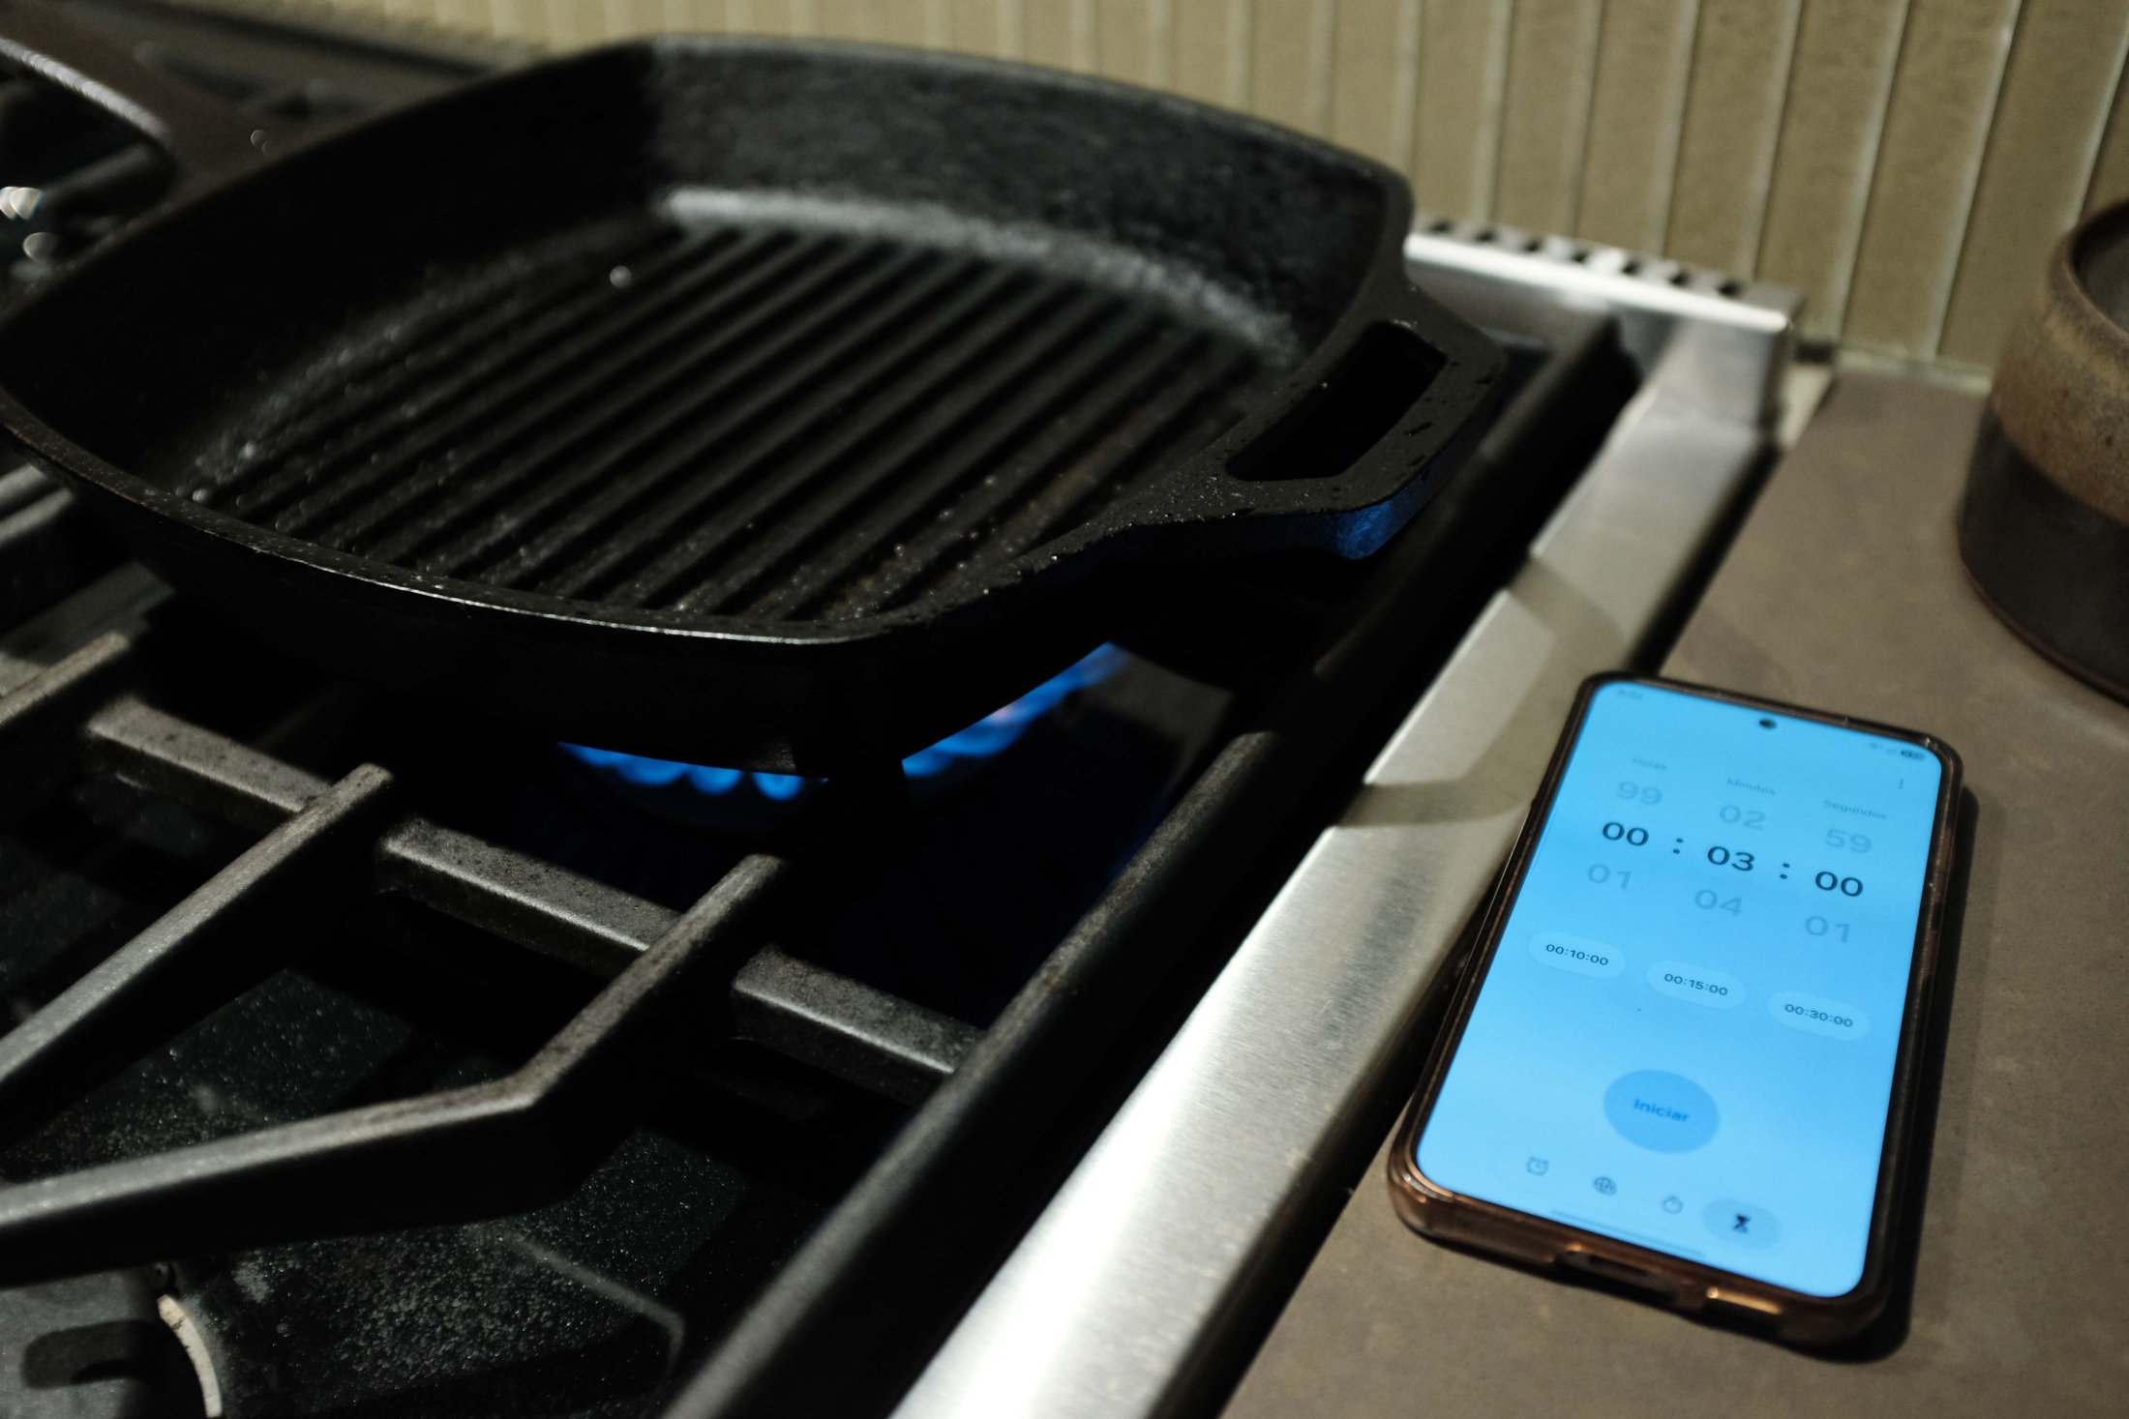
High heat for 3 minutes after washing.

Slide 22
High heat again!

Slide 23
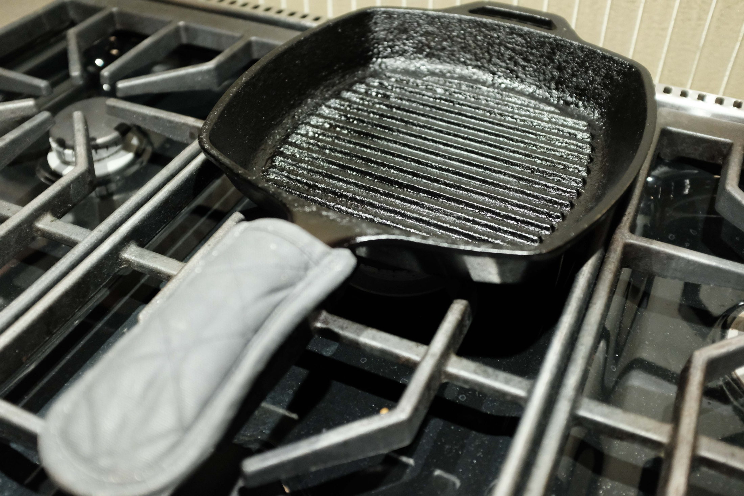
Be careful. The grill is hot after 3 minutes on High.

Slide 24
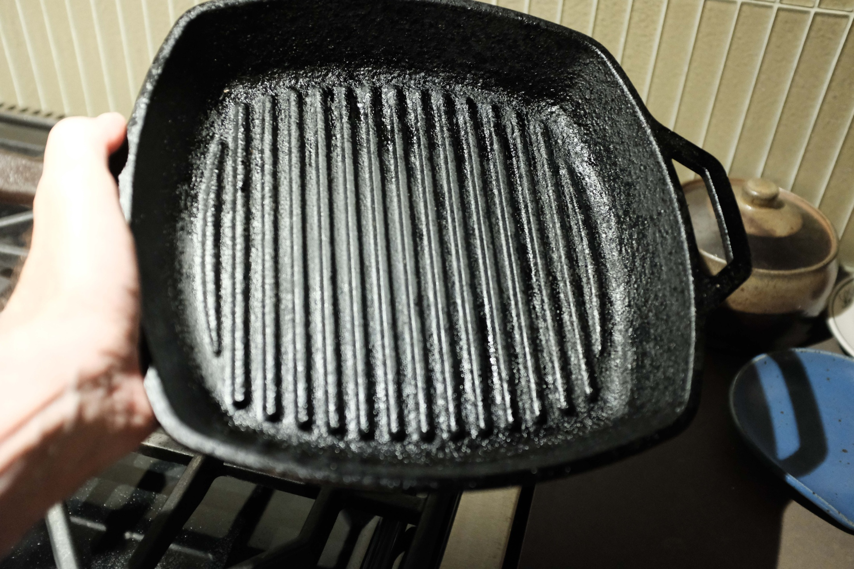
Clean, dry, free of oil and ready for next use.

